Slide 1
SALES DASHBOARD
By Supriya Jadhav

Slide 2
Objective
The purpose of this dashboard is to provide a comprehensive overview of sales performance, cost structure, and profitability across regions and product lines. It enables stakeholders to:
Monitor revenue, cost, and net profit trends over time
Understand sales distribution by product categories and countries
Analyze payment behavior and order status patterns
Identify top-selling and underperforming product categories

Slide 3
Overall Business Performance
At the top of the dashboard, four KPIs give a quick snapshot:
Total Revenue: $1,471,551
Total Cost: $957,252
Total Net Profit: $514,299
Total Quantity Sold: 2,999 units
These metrics demonstrate healthy profitability, with net profit contributing approximately 35% of the revenue.

Slide 4
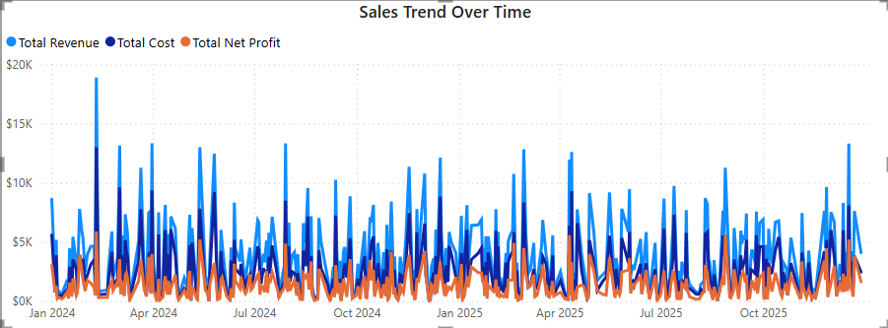
Sales Trend Over Time
How have sales performed over time ?
The time series line chart shows daily trends in revenue, cost, and profit from January 2024 to December 2025. Notable spikes indicate strong sales periods, potentially driven by promotions or seasonal demand. This helps identify peak months and plan inventory accordingly.

Slide 5
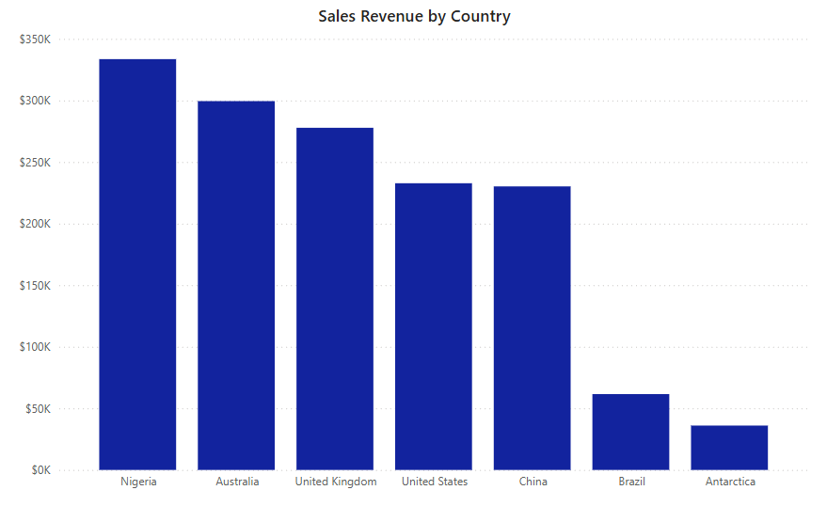
Sales by Country
Which countries generate the most revenue ?
Nigeria leads in total revenue, followed by Australia and the United Kingdom.
These top-performing countries contribute significantly to the business and may offer opportunities for deeper market penetration.

Slide 6
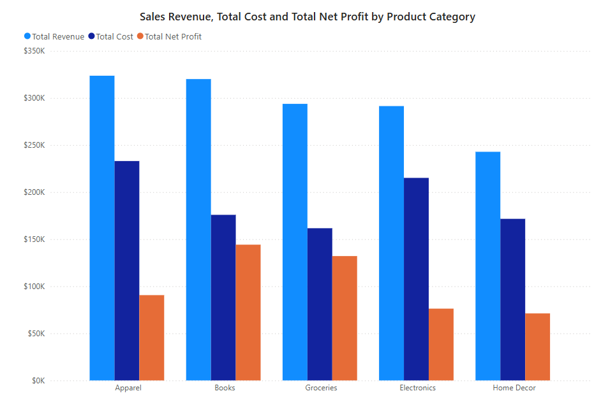
Performance by Product Category
Which Product Categories are most profitable ?
The bar chart compares total revenue, cost, and net profit by product category:
Books and Apparel generate high revenue and profit margins.
Electronics shows moderate revenue but lower profitability, suggesting cost optimization is needed.

Slide 7
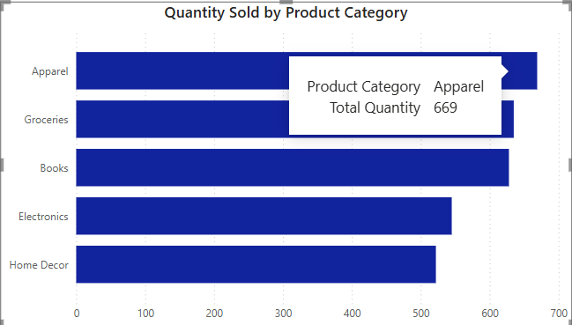
Quantity Sold by Product
Apparel and Groceries are the top-selling categories by volume.
Home Decor shows the lowest sales volume, signaling a potential need for marketing or product strategy review.
Indicates consumer interest trends and helps manage stock levels.

Slide 8
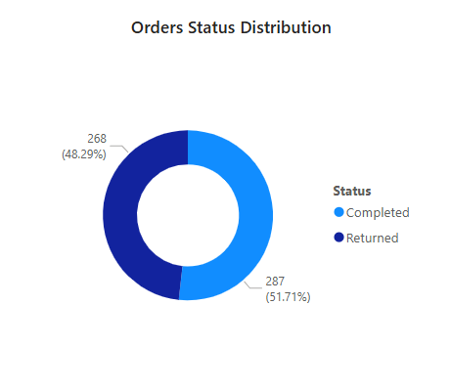
Order Status Distribution
51.71% of orders were Returned, which is a critical red flag.
This indicates a high return rate and may reflect product quality issues or mismatch in customer expectations.

Slide 9
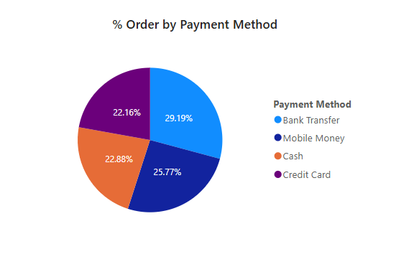
Payment Method Preferences
Bank Transfer and Mobile Money are the most popular payment options.
Knowing the preferred payment modes helps optimize the checkout experience and improve conversion rates.

Slide 10
Tools Used
Power BI Desktop: Data Visualization
Microsoft Excel: Raw Data Source
DAX: Calculated Columns and Measures

Slide 11
Conclusion
This dashboard turns raw sales data into a visual story of business performance. It helps:
Spot emerging trends
Pinpoint problem areas
Drive data-informed decisions

Slide 12
THANK YOU

